Slide 1
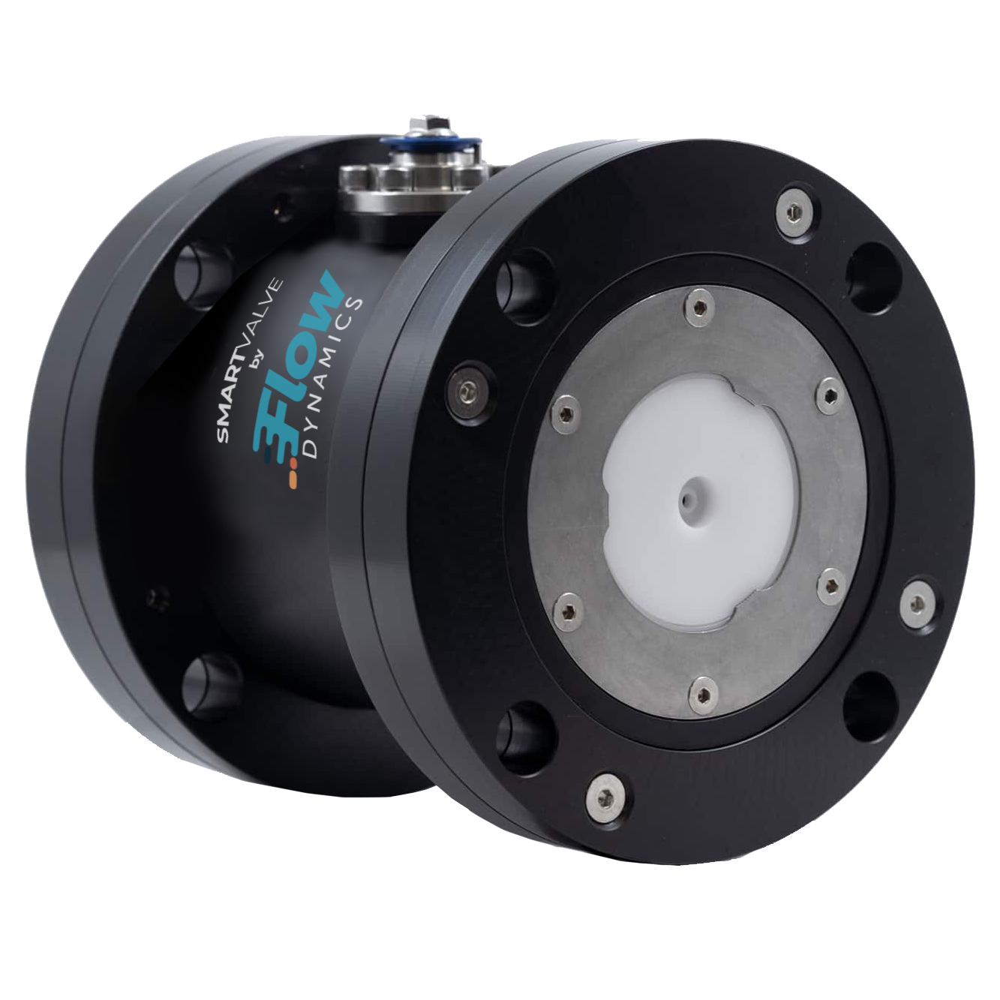
SMARTVALVE
TM
Manufactured by

Slide 2
What is the SMARTVALVE?
A Flow Management Device that will save the user money on their water and sewer bill by:
Improving water meter accuracy – STOP PAYING FOR AIR and TURBULENCE
Conserving water in certain types of uses
Protecting equipment from damage and wear due to pressure surges

Slide 3
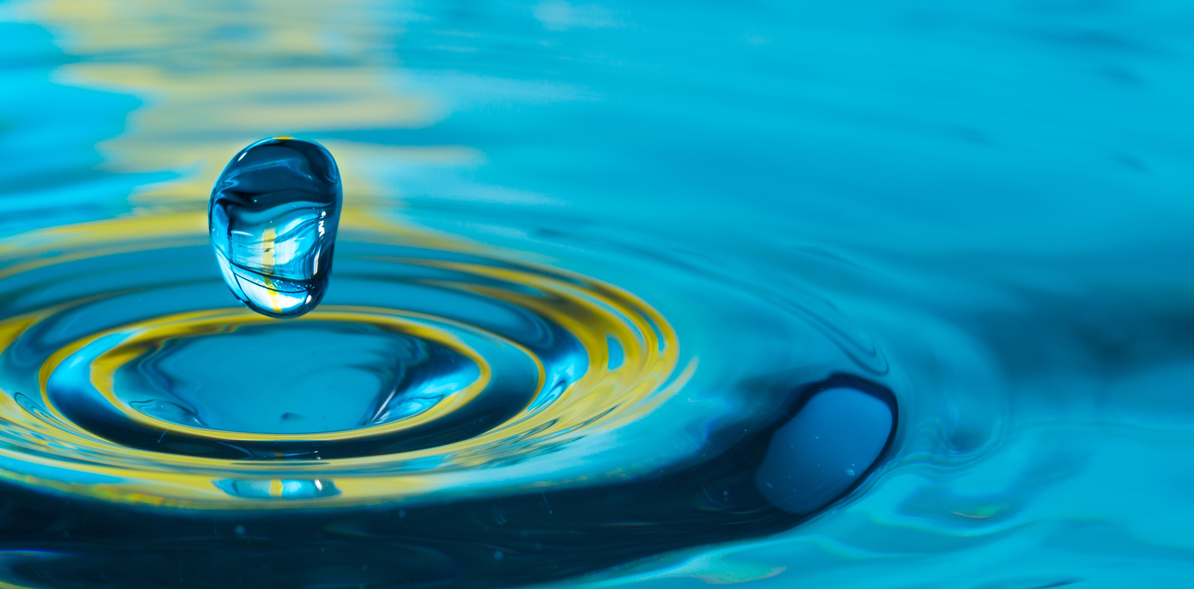
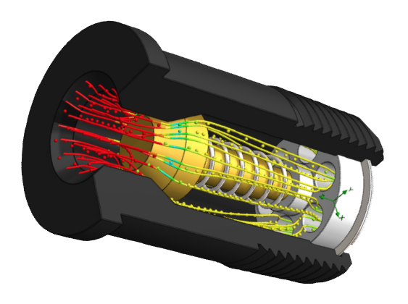
History & Performance
2008 - Edgeworth invents the technology and begins R&D
2010 - First commercial installations
2012 - Technology purchased by Flow Dynamics
2014 - First Patent Issued (8,707,981)
2017 - 2ndGeneration valve developed
2020 - 2ndGen Patent issued (10,544,569)
2021 - 2-Stage Patent issued (11,016,512)
NSF 61 & 372 certified (potable water and lead free)
Over 15,000 installed and growing rapidly
Most customers see savings between 15-25%

Slide 4
The Problems with Water Delivery
WATER METERS ARE INACCURATE DUE TO PHYSICS OF FLOW
Over 99% of water meters in use measure by VOLUME. This means any air volume gets billed as water.
It’s a fact that there is air in water lines. Plumbing systems must be properly designed to avoid air blocks and air hammering.
Turbulence also causes meter inaccuracy.
Water meters can over spin.
Water meters are designed to be accurate within a specific range of GPM.
Higher than 60-65 PSI can cause over delivery of water.
Ideally Separated Bubble Flow
Interacting Bubble Flow
Churn Turbulent Bubble Flow
Clustered Bubble Flow

Slide 5
The Smart Valve Solution
Water Meter
Install after water meter and before pressure reducer or boost pump. Soon after the backflow preventer is usually a good place.
How does this work?

Slide 6
The Smart Valve Solution
The Smart Valve maintains a pressurized column of water UPSTREAM past the water meter that prevents the pressure drop caused by user demand from reaching the water meter, and therefore preventing air volume from increasing at the meter.
It eliminates turbulence and over spinning of the meter caused by surges and the sudden on and offs of typical water demand.
It keeps the flow rate within the range the meter was designed to accurately operate.

Slide 7
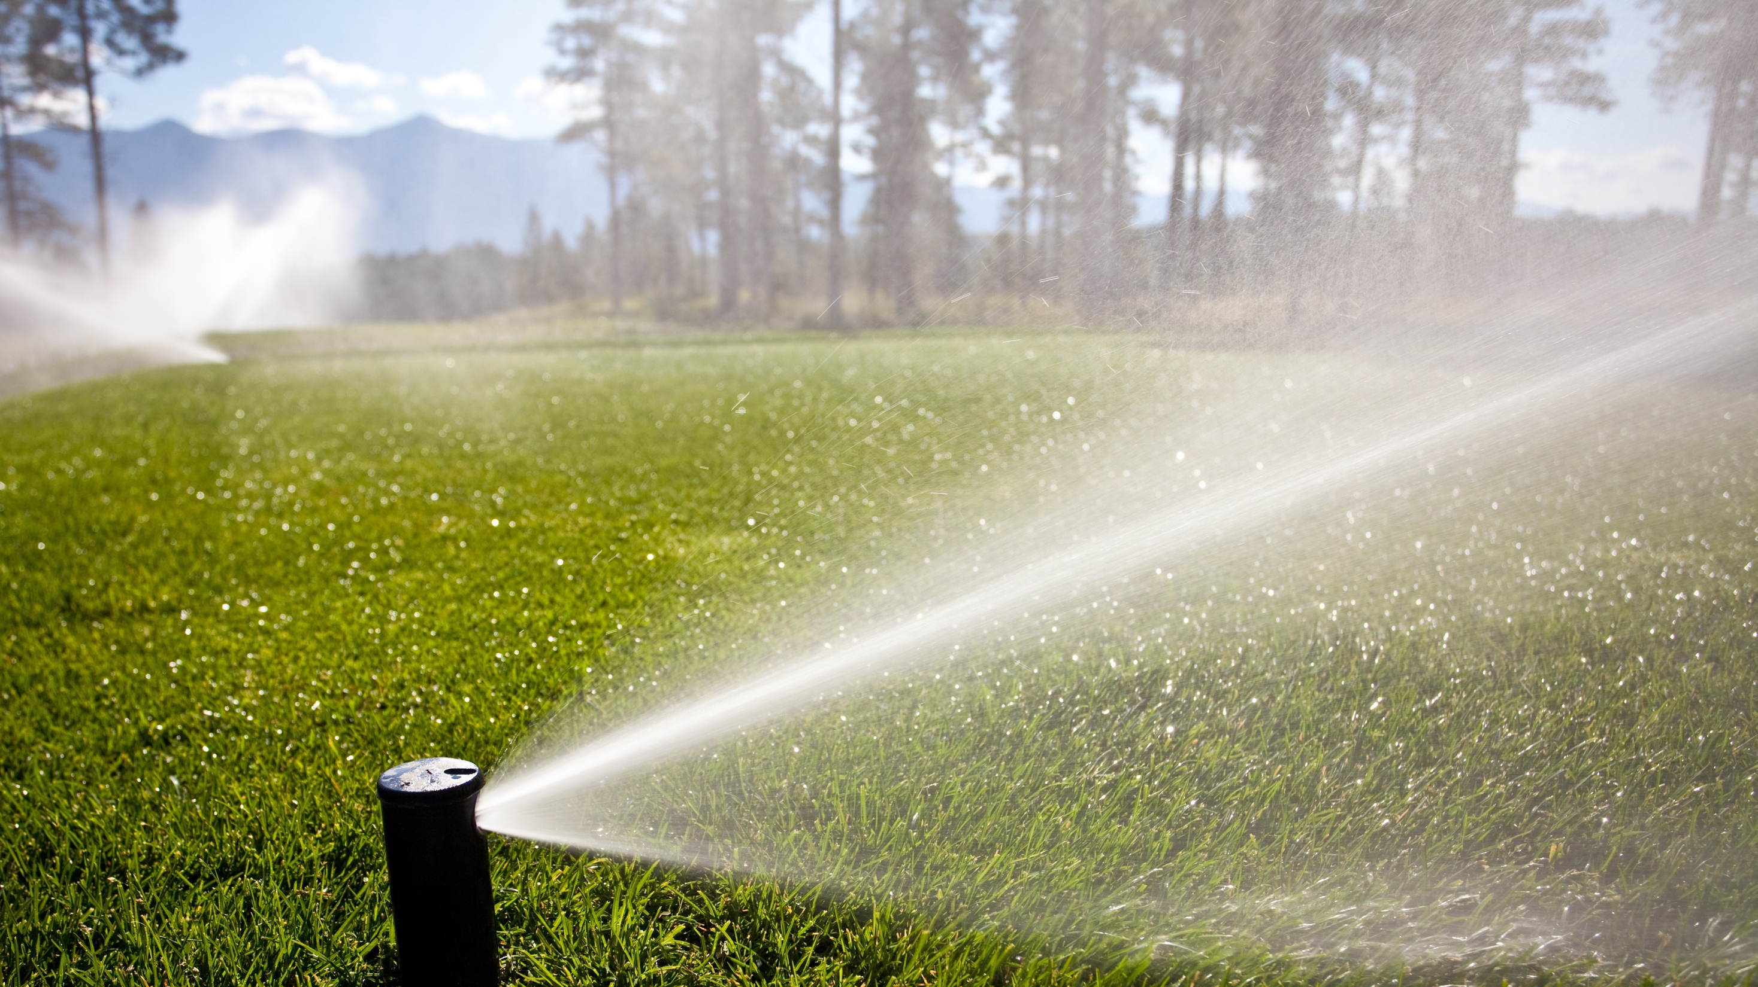
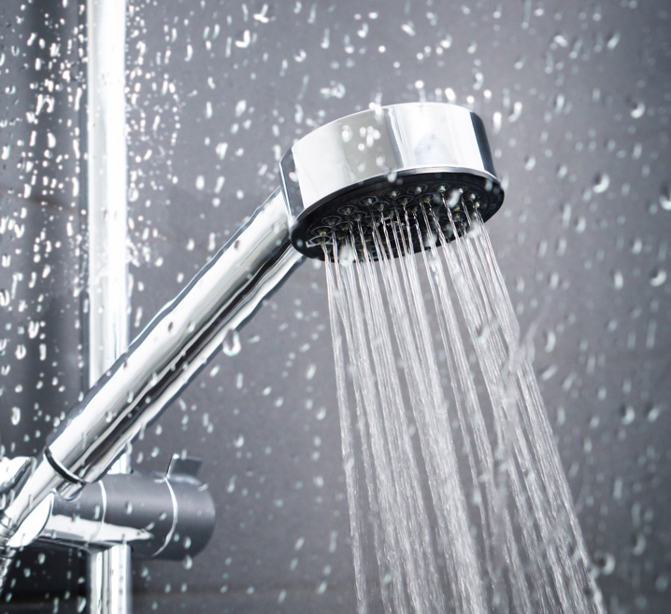
Water Conservation
The Smart Valve can also conserve water in non-volumetric applications such as showers, faucets and sprinklers.
The accompanying PSI drop ‘slows down’ the flow rate. The same 5-minute shower will deliver slightly less water. You won’t notice the difference in the shower but it can add up on your water bill.
Reduces over-delivery of water due to high pressure and a lack of flow regulators and/or pressure reducers, which often fail unknowingly.

Slide 8
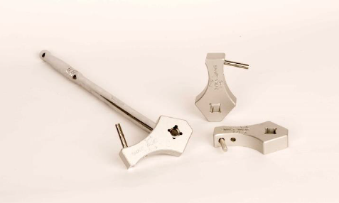
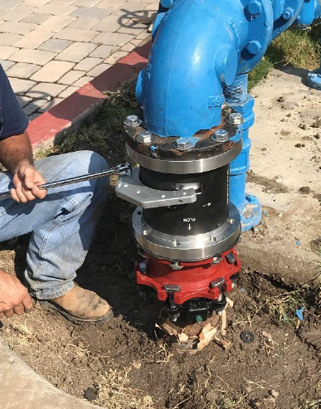
Adjustment
The Smart Valve is calibrated to the user system AFTER installation.
This allows fine tuning adjustments to find the ideal setting every time, without ever having to interrupt water supply.
Allows user to make adjustments to potential changes in pressure or flow without a plumber, and without a water shutdown.
Allows user to turn the valve to ‘zero effect’ setting in case of severe pressure drop (such as a city main break).

Slide 9
Installation Examples

Slide 10
Thank you
Chris Taylor
Owner, Puractive Solutions, a Distributor of Flow Dynamics
Chris@puractivesolutions.com
(760) 390-0977

